Slide 1
Pain Management
Submitted By
Shivam Goel
Hari Charan Panjwani

Slide 2
Introduction
An iOS Application for Boston Medical Center Program for Integrative Medicine and Health Disparities which access cronic pain and cronic condition of patient on answers to selected list of question provided in application as suggested by doctor
Answer selected will be submitted to doctor as a Report
Based on the report doctor can add patient to related groups to initiate chat
Based on answer app can provide the link of YouTube video which can ease the pain of patient.

Slide 3
Chat Application
User can chat to the groups added by doctor
User can send images from Photo Library or camera
There can be public groups which are available for all the users
Doctor will be monitoring the groups
Chat Application has feature of push notification
Implemented didEnterBackground ad didEnterForeground methods for application

Slide 4
QuickBlox
Quickblox is a cloud hosted platform (PaaS) designed to simplify your mobile application development to add new functionality, add scalability, and quicken time to market
Cloud based app Content Management System (CMS)CMS editor (easily manage text and rich media content within your apps – No need to constantly republish with every change!)
The connections are protected by secure connection protocol, a modification of OAuth, there is additional security in the case of the latter as you own your data and user base, there is also a system of automated backups allowing us to restore your data within a few hours if something outstanding happens. You may also export your data to XML at any time through your backend panel.

Slide 5
Video
User can watch YouTube video of the links provided my doctor
User can watch the video provided by the doctor
Feedback of Video from user

Slide 6
Enhancement
Login(Database Modification)
Edit User Profile
Report Creation on answer submit
Modified the Program Detail Page
Adding User to Patient profile on server side.

Slide 7
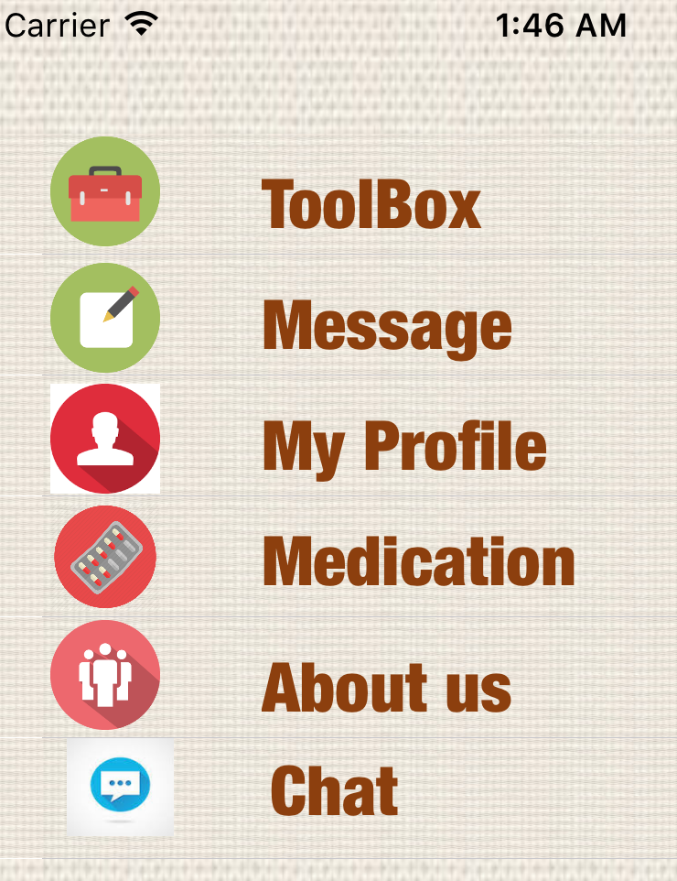

Slide 8
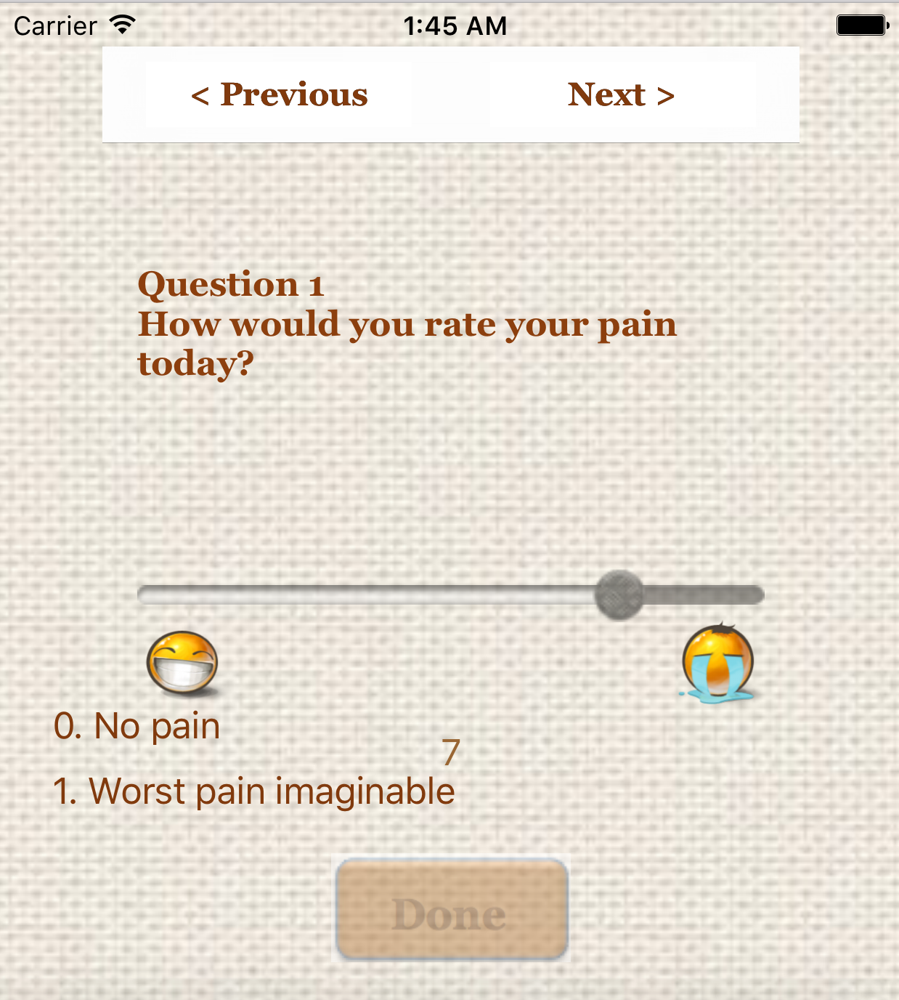

Slide 9
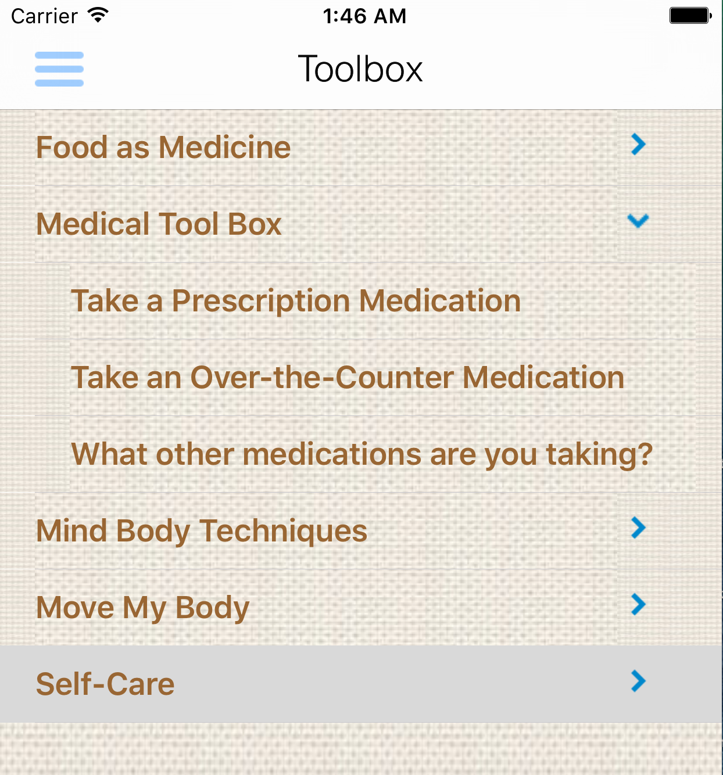

Slide 10
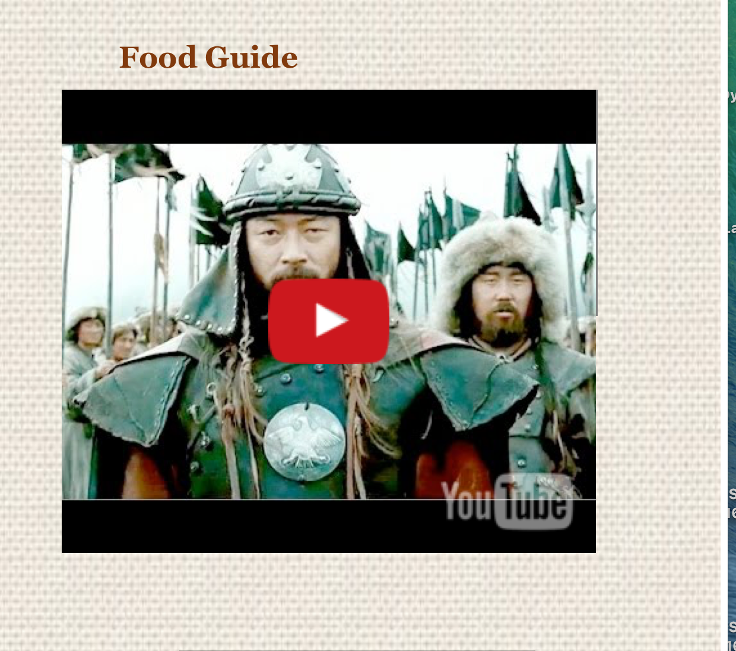

Slide 11
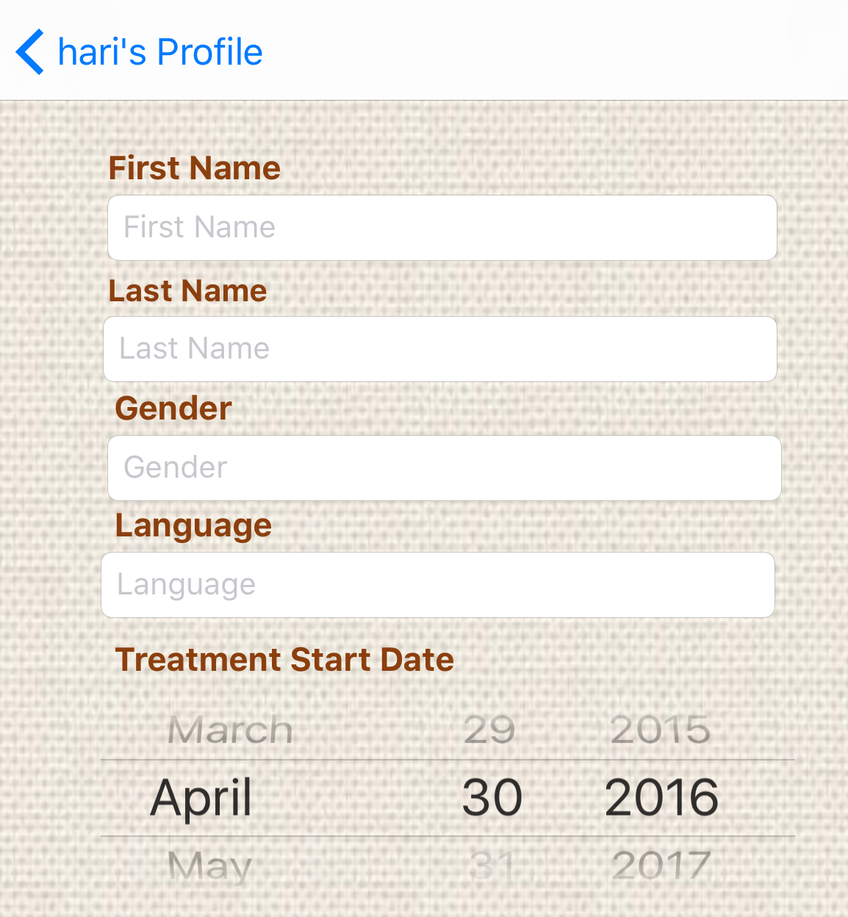

Slide 12
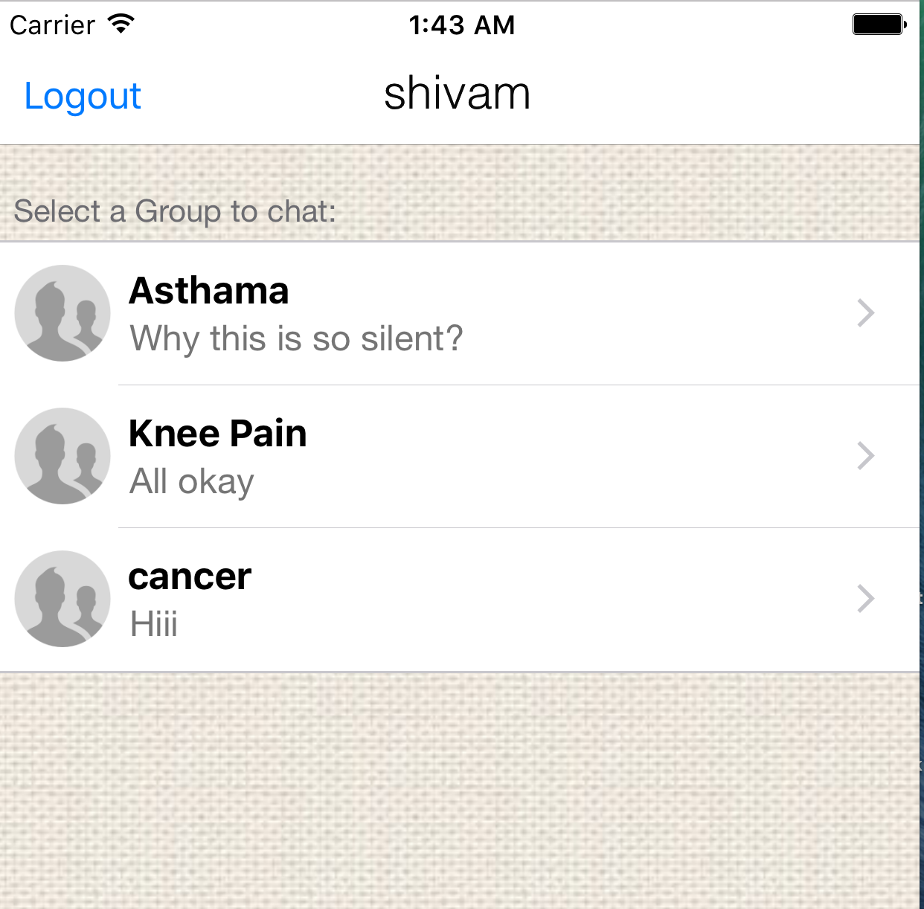

Slide 13
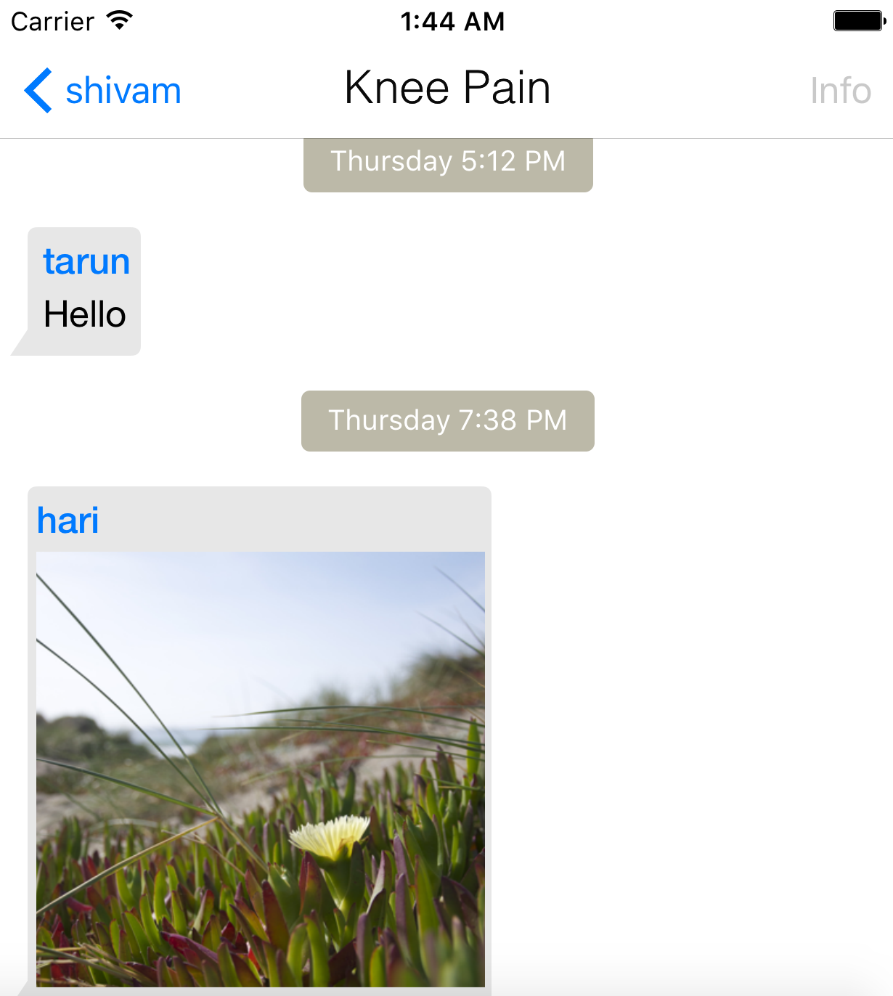

Slide 14
THANK YOU

